Slide 1
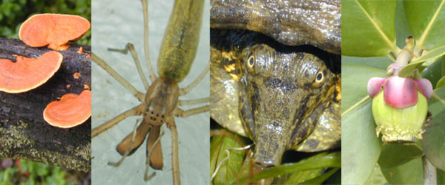
GENERAL BIOLOGY fdn 1203
Dr. Theja Abayarathna
Department of Biology
Faculty of Applied Sciences
Rajarata University of Sri Lanka

Slide 2
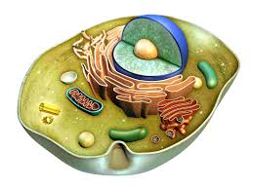
The Cell – As the basic unit of life

Slide 3
Cell is the basic unit of structure and function of living things
Cells Tissues organs
Individual organ systems

Slide 4
Cell theory
Proposed by Schlieden and Schwan in 1838
It includes 3 principles.
All organisms are composed of one or more cells and metabolism and hereditary occur within these cells.
Cells are the smallest living things, the basic units of organization.
Cells arise only by division of previously existing cell.

Slide 5
Cell as a self-contained unit
Cell though very small , it acts as an autonomous unit.
Cells….
carry out all vital biological processes.
oxidize the food molecules - produce energy and store these energy rich molecules
build new structures and can replace worn out cells by using nutrient molecules .

Slide 6
repair and exchange gases with its surrounding
replicate its own self
have their own lifespan

Slide 7
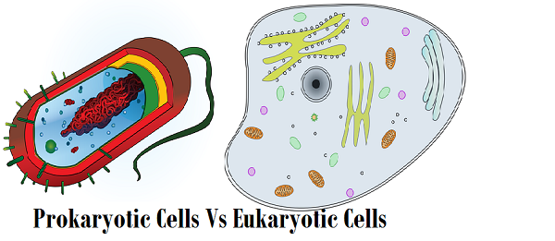
Prokaryotic and Eukaryotic cell
According to the cell structure there are two types of cells
Prokaryotic cell
Eukaryotic cell

Slide 8
Prokaryotic Cell
prokaryotes is the term given to organisms without true nucleus.
hereditary material called DNA is not enclosed in a membrane / no membrane bounded internal structures.

Slide 9
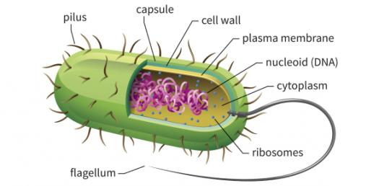
Structure of prokaryotic cell
We consider Bacterial cell as an example for Prokaryotic cell.

Slide 10
Bacteria cell is composed of different parts.
Cell wall
Most bacteria are encased by a strong cell wall made up of peptidoglycon.
No Eukaryotes possess cell walls with this type of chemical composition.

Slide 11
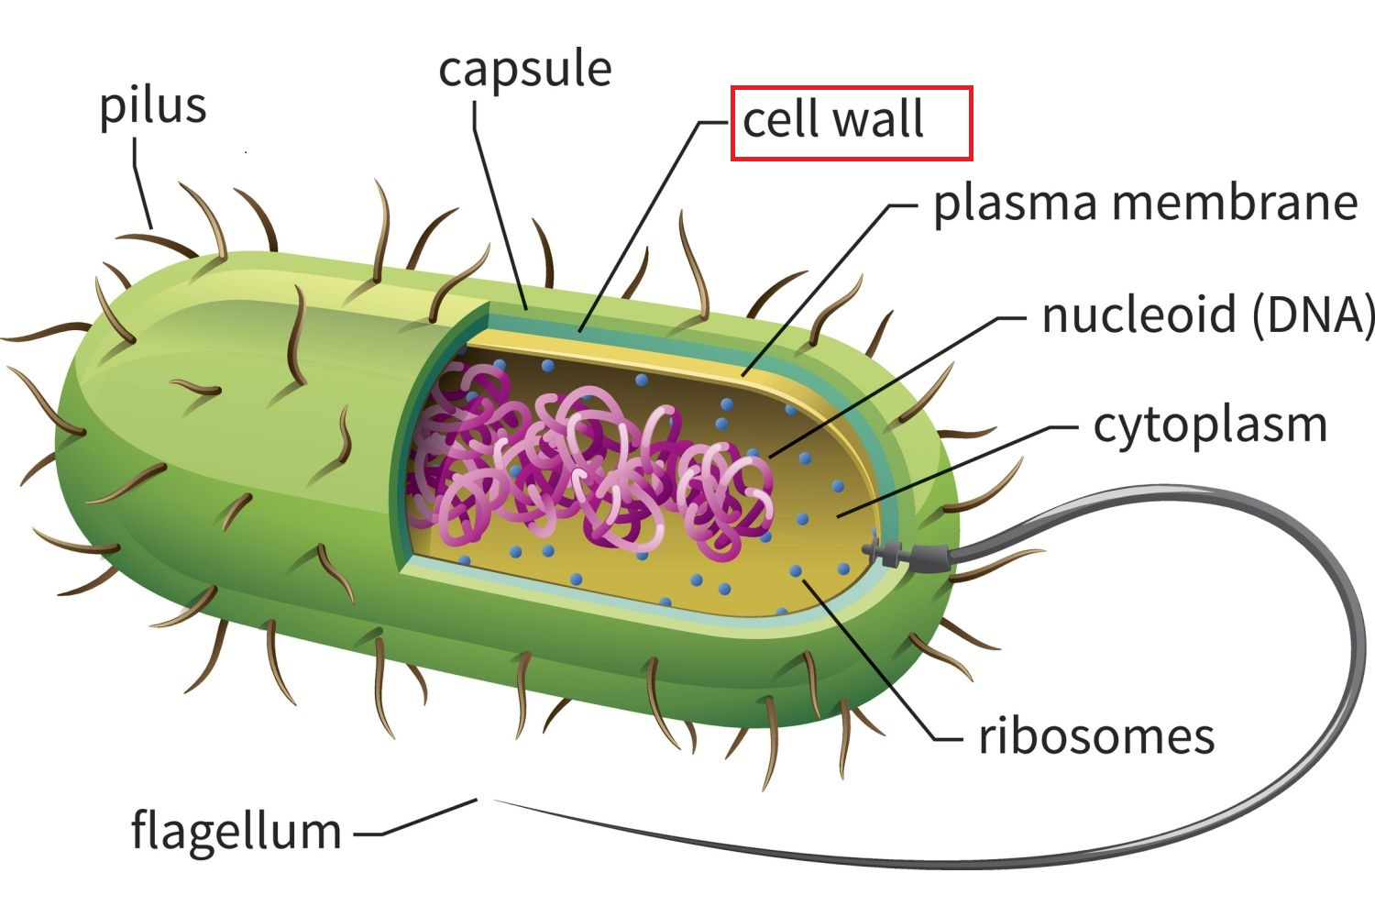

Slide 12
Capsule
The cell wall is covered by a capsule or slim layer.
It gives additional protection to the cell from unfavorable conditions.
Helps to stick to each other and form colonies.
Helps to stick to the surface of the food supply or to the host cell.

Slide 13
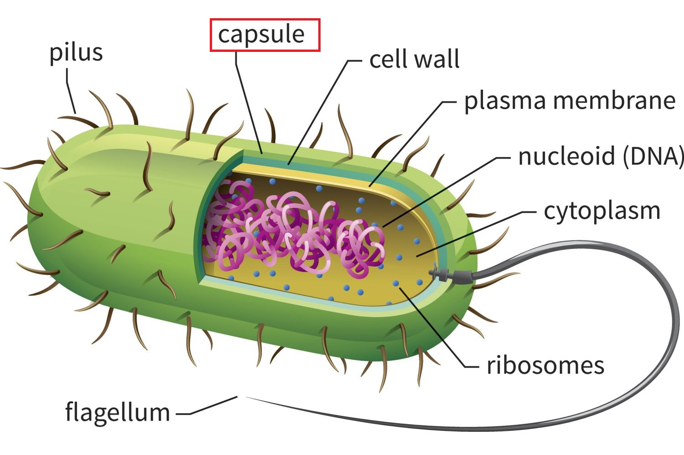

Slide 14
Plasma membrane
Below the cell wall there is a membrane called plasma membrane.
It is selectively permeable. It permits some molecules to pass through it. But not others.

Slide 15
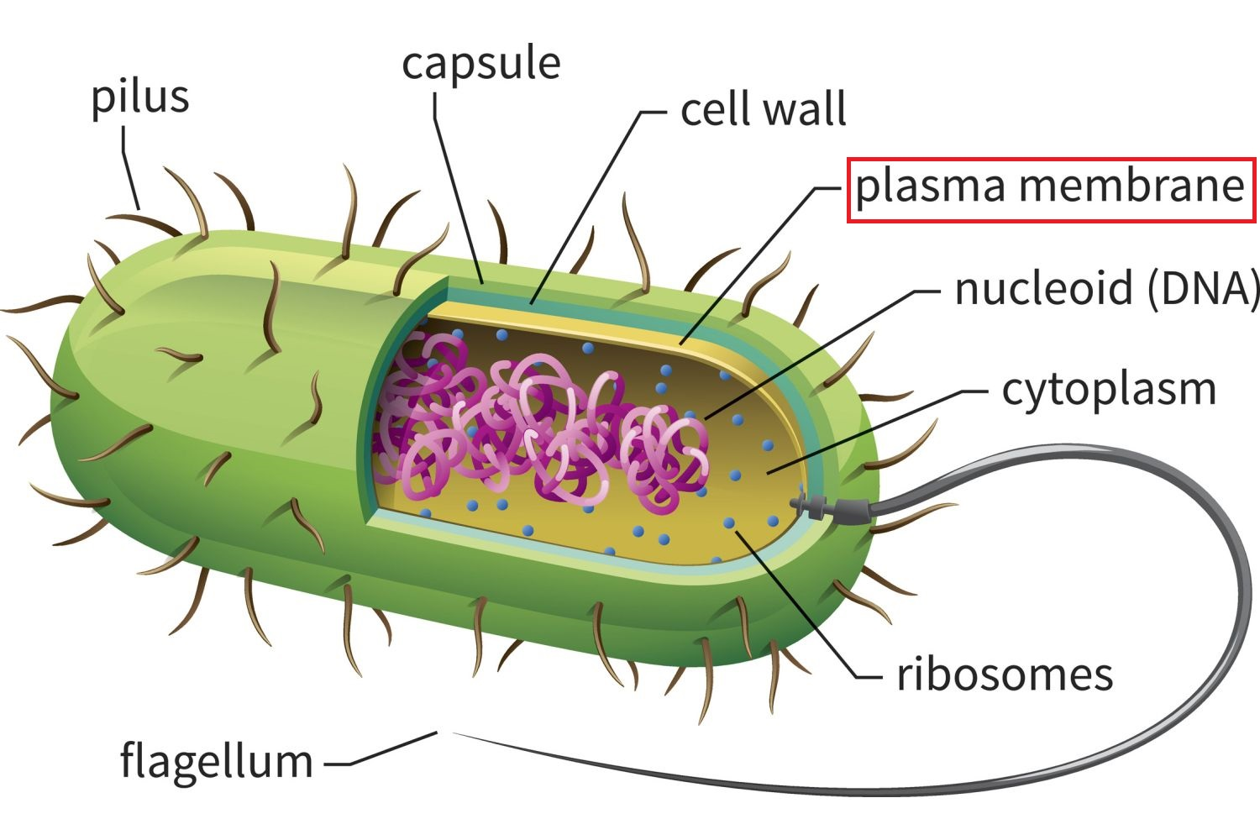

Slide 16
Cytoplasm
Plasma membrane encloses the cytoplasm.
It looks granular due to the presence of ribosome.
There are enzymes, carbohydrates, lipids and genetic materials can be found in the cytoplasm.

Slide 17
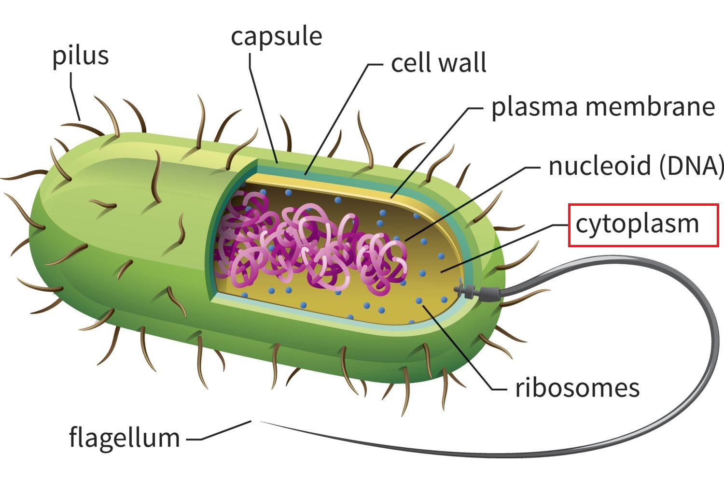

Slide 18
Flagella
Many bacteria are equipped with one or more flagella.
It helps bacteria to move and to respond to stimuli.

Slide 19
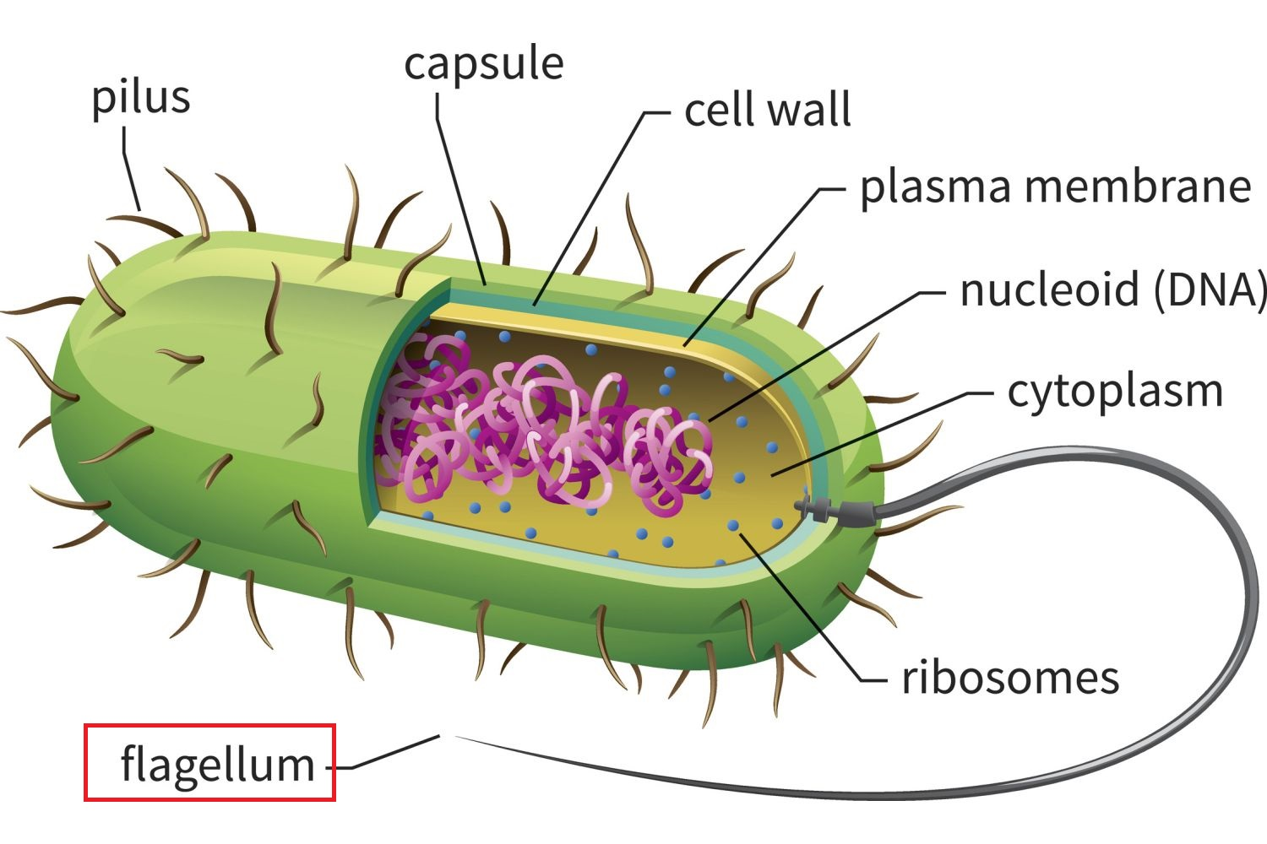

Slide 20
Thank you!

